Slide 1
The Fire and the rain
Girish Karnad
Presented by-
Milind Bedse
Assistant Professor, Department of English
Shri Chhatrapati Shivaji Mahavidyalaya, Shrigonda,Dist.Ahmadnagar

Slide 2
Prologue
Act 1
About Author
Act 2
About Play
Act 3
Characters
Epilogue
The Myth of Yavakri

Slide 3
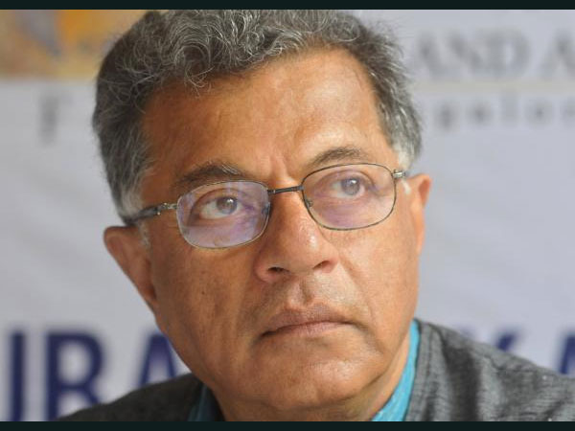
About Author
Girish Karnad (19 May 1938 – 10 June 2019)^{[1]} was an Indian actor, film director, Kannada writer,^{[2]} playwright and a Rhodes Scholar, who predominantly worked in South Indian cinema and Bollywood. His rise as a playwright in the 1960s marked the coming of age of modern Indian playwriting in Kannada, just as Badal Sarkar did in Bengali, Vijay Tendulkar in Marathi, and Mohan Rakesh in Hindi.^{[3]}
He was a recipient of the 1998 Jnanpith Award, the highest literary honour conferred in India.^{[4]}
For four decades Karnad composed plays, often using history and mythology to tackle contemporary issues. He translated his plays into English and received acclaim.
Cont.

Slide 4
About Author’s Play
Tughlaq,
Hayavadana,
Yayati,
Nagamandala: Play with Cobra,
Fire and the Rain, 1998.
Bali : The Sacrifice,
Tale Danda,
Wedding Album,
Boiled Beans on Toast, 2014.
Crossing to Talikota, 2019.
End

Slide 5
About the Play
Translated work of Kannada play “ Agni Mattu Male”.
Angni and Rain have set counterpointing to each other such as Indo-Aryan and Dravidian language..
Between the Sacred and the Secular.

Slide 6
The myth of Yavakri
The myth of Yavakri (or Yavakrita) occurs in Chapters 135-38
of the Vana Parva (forest Canto) of the Mahabharata.
It is narrated by the ascetic Lomasha to the Pandavas as they wander across the land during their exile.

Slide 7
Characters
Raibhya
Paravasu
Arvasu
Vishakha
Yavakri
Nittilai
Brahma Rakshsa
Andhka
Actor-Manager

Slide 8
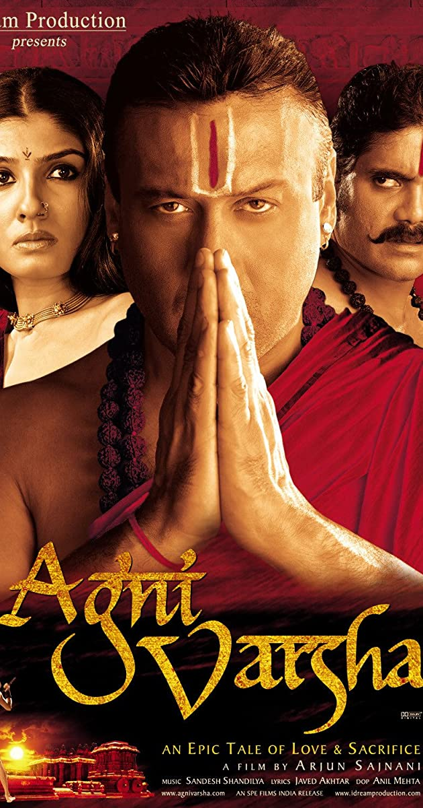
Paravasu
28th Year Old
Elder son of Raibhya
The King has appointed him the Chief Priest.
Unemotional
Villain by nature

Slide 9
Yavkari
Main Character
Wants to take revenge
Spend 10 years in penance
Killed by Brahma Rakshasa
Do adultery with Vishakha

Slide 10
Arvasu
Age about 18
Younger brother of Paravasu
Antithesis of other Characters
Loves to act in Drama
Loves to Natilai, a tribal girl.

Slide 11
Raibhya
Father of Arvasu & Paravasu
Jealous and Lustful
Killed by his son Arvasu.

Slide 12
Vishakha
Wife of Paravasu
Age about 26

Slide 13
Nittilai
A tribal girl of 14
Loves to Arvasu
Rational girl

Slide 14
Brahma Rakshasa
Indra
Actor-Manager

Slide 15
What is Prologue?
Prologues have an important role in a novel or Play
They provide the readers and viewers with an introduction into the story that will unfold.
It could foreshadow the conflict or might even provide a little back story.

Slide 16
What is Epilogue?
Epilogue is located at the end of a story.
It describes events which happened after all the plots had been finished.
It tells what happened to main characters of the story.
a final or concluding act or event.

Slide 17
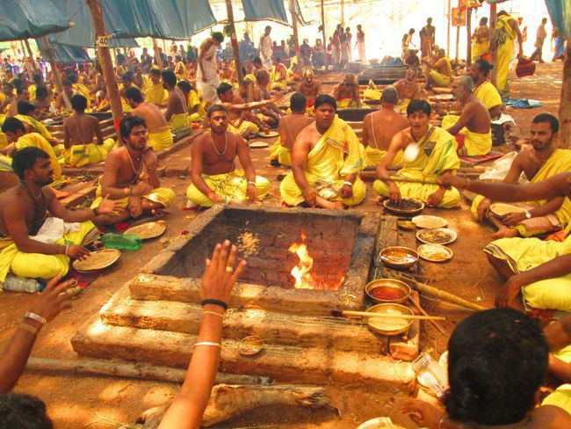
PROLOGUE
Setting
Extreme drought has gripped the land in want of adequate rain for the last ten years.
A Seven-year long fire sacrifice(Yajna) is being held to propitiate Indra, the god of rains.
Priests continuously sing a hymn.
The King is host.
Paravasu is the Chief Priest.
Afternoon session is over.

Slide 18
PROLOGUE
A Courtier enters with the Actor Manager.
Actor-Manager wants permission to present a play on this occasion.
He expresses the message of Arvasu to Paravasu.
Explains the significance of play .

Slide 19
PROLOGUE
After getting the permission all the actors will be performed the play in front of King, Paravasu, other priests and general public.
Arvasu hopes that Nittilai watches them.

Slide 20
ACT I
Arvasu and Nittilai go towards the hermitage of Yavakri’s father
Arvasu & Nittilai fall in love together .He belongs to Brahmin Caste and She belongs to Tribal Community.
The play opens with a casual dialogues with rational approach of Nittilai.
Nittilai makes request that don’t bother yourself about the meeting.
The community organises a council.

Slide 21
ACT I
At hermitage of Yavakri’s father
Andhaka , blind man sitting at the gate of hermitage.
Arvasu talks about his desires. Even he born in Brahmin Caste he like to dance, act etc..
Andhaka give information about Yavakri, how he spend ten years in penance to achieve his goal.
Nittilai raises the questions about Brahmins hypocrisy.

Slide 22
ACT I
At hermitage of Yavakri’s father
Nittilai raises the questions about Brahmins hypocrisy.
She wants to ask two important questions to Yavakri.
1.Whether Yavakri make it rain?
2.Whether he knows when he would die??
Andhaka informs to Arvasu , Yavakri wants to meet him when the sun is overhead.

Slide 23
ACT I
Near the hermitage of Raibhya
Vishakha, 26 years married woman, scoops a water from holes,dug in the pot. Yavakri stops her.
Yavakri humbly request her to listen him.
Talks about UNIVERSAL KNOWLEDGE.
Yavakri seduces her.
Conversion on past times.
Vishakha talks about the situation of marriage.
How she live alone since seven years.
Her sexual desire compares with ‘dry like tinder’.
They go behind the Champak Tree.

Slide 24
ACT I
Near the hermitage of Raibhya
Nittilai and Arvasu enters after a long pause
Nittilai tells Arvasu to meet Yavakri the next day.The tribal elders would be angry if they reach late.
Near the stream they see the pot of Vishakha.
Nittilai observes that Vishakha carefully put it down so that even a drop does not spill.
Follows the footprints.
Find Vishakha and Yavakri in the bushes.

Slide 25
ACT I
Near the hermitage of Raibhya
Nittilai curses to Yavakri for his adultery.
Vishakha hurriedly go towards the home; Arvasu follows her with water pot.
At the hermitage of Raibhya. Raibhya appears

Slide 26
ACT I
Near the hermitage of Raibhya
Nittilai curses to Yavakri for his adultery.
Vishakha hurriedly go towards the home; Arvasu follows her with water pot.
At the hermitage of Raibhya. Raibhya appears
Raibhya knows the truth of Yavakri.
He curses to Vishakha.
In anger, he sits cross-legged and madidates.
He challenges to Yavakri for getting protection.
Vishakha & Arvasu run opposite side to search Yavakri

Slide 27
ACT I
At the hermitage of Raibhya.
Raibhya from his hair creates Brahma Rakshasa.
He holds a trident.

Slide 28
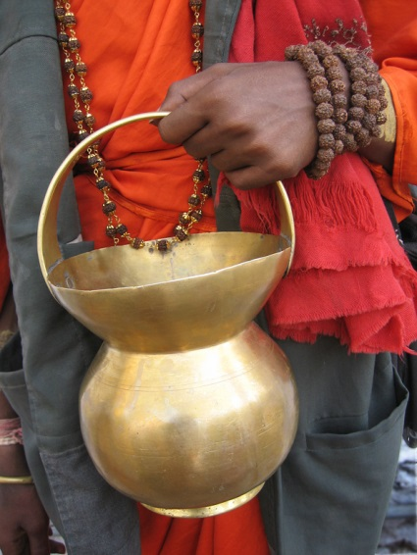
ACT I
Arvasu reaches at Yavakri’s father hermitage to find Yavakri.
He informs to Andhakha about the danger .
Vishakha finds Yavkari.
She advises him to hide in the hemitage of his father.
But, Yavakri consecrated water ,in his Kamandalu ,with has the potential of evaporating the Brahma Rakshasa.

Slide 29
ACT I
Arvasu reaches at Yavakri’s father hermitage to find Yavakri.
Yavakri reveals his revenge.
Vishakha pours the water from kamandalu.
Act 1 is end with the death of Yavakri.

Slide 30
ACT II
In the Evening
Arvasu reaches for meeting with Tribals’ council
Arvasu reaches very late for the meeting. Meanwhile Nittilai’s father announces those will come forward he will be married with my daughter nittilai. A young boy came forward.
Arvasu ugres a lot , but time was over.
The boys beats him.

Slide 31
ACT II
Night
Arvasu reaches the hemitage of Raybhya.
Arvasu lies down in the corner of the varanda.
Meanwhile, Paravasu also comes in that night.
Rabhya feels horrified and curses a lot .
Paravasu wants to meet his wife, Vishakha.He meets her in alone.
Raibhya goes towards the forest.
Arvasu waits on the nearest tamarind hill.

Slide 32
ACT II
Night
After the conversion with Vishakha, Paravasu makes the conclusion that his father Raibhya became jealous and he creats some obstacles during the fire sacrifice therefore he would be created Brahma Rakshasha.
Raibhya comes very silently to listen What they talk to each other.
Paravasu takes the bow and arrow and points towards Vishakha, and suddenly he listens the coughing of Raibhya , he moves the arrow around so that it points in the direction of Raibhya.

Slide 33
ACT II
Night
Raibhya is killed by Paravasu. Arvasu enters there. Paravasu told him that I thinks it may be an animal , so I arrowed that side. Unfortunately, he was our father. I unknowingly killed him.
Arvasu cries like a child.
Paravasu instructs to Arvasu to cremate the body immediately and concentrate on the performance of the penitential rites.

Slide 34
ACT II
Night
Brahma Rakshasa confronts Paravasu in the forest.
Brahma Rakshasa called himself the brother of Paravasu and Arvasu.
He wants Mokshya.

Slide 35
ACT II
Night
After completing the funeral rites.
Arvasu do it alone. When he reaches at home , he finds that Vishakha is not in home.
Then he reaches to the fire sacrifice place. He sits there and sings a hymn.
He has been asked the questions by other priests.Paravasu does not recognize him.
The guards push him back.

Slide 36
ACT III
Night
The outskirts of the city. The stage is filled with bodies of people sleeping. Nittilai sleeps next to Arvasu.
Arvasu behave like a child.
Nittilai tells her purpose to come there.
Arvasu thinks that his brother did this conspiracy to stay away from Nittilai.

Slide 37
ACT III
Night
Actor –Manager comes
Actor-Manager comes.
He admires Nittilai’s selfless love and devotion for Arvasu.
In the background Nittilai’s brother and husband enter. They make a fire and sit near it.Nittilai sees them.
Aravsu asks to Actor-Manager about their life.
A-Mangaer admires Arvasu’s dance.

Slide 38
ACT III
Night
Nittilai comes rushing in.
Arvasu sents her in the forest to became safe.
Actor-manager tells him about the performance.
The Play “The Triumph of Lord Indra” is ready for performance.
Vritra acted by Arvasu; & Indra acted by Actor-Mangaer.
The Actor-Manager comes with costumes and the masks of Virtra.

Slide 39
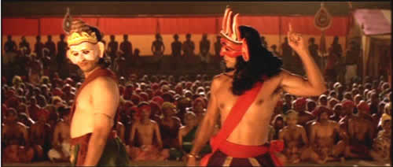
The Epilogue
Night
Arvasu puts on the mask of Vritra.
Dramatic Technique –Play within play.
Entitled “ The Triumph of Lord Indra”.
Arvasu performs the role of Vritra.
Actor-Manager performs the role of Indra.

Slide 40
The Epilogue
Aravsu enters on the stage and dance violently and wild roar and jumps up.
Vishwarupa( brother of Vritra) and Vritra dance together for showing their bounding.
Both are the son of Lord Brahma.
Indra invites Vishwarupa for fire-sacrifice ceremony to glad their father Lord Bramha
But Indra does not give permission to Vritra to enter the Altar. Becasue his mother was demoness.
Vishwarupa only enters there.

Slide 41
The Epilogue
Only gods and good people are invited.
Vritra says that Gods should never be trusted. This Indra is treacherous.
Brahma gives birth to Vritra to protect Vishwarupa.
Vishwarupa only enters there.
Indra laughing silently ,moves behind him, takes up his thunder-bold takes aim and plunges it into Vishwarupa’s back.Vishwarupa screams.

Slide 42
The Epilogue
Paravasu , who has been watching impassively until now, jumps to his feet.
Brahma rakshasa stands behind the Paravasu talks to each other.
Brahma Rakshasa wants his Mukti.
Paravasu explains the means of this act.

Slide 43
The Epilogue
Vitra enters in the enclosure.
Ask about this treachery.
Vitra catches the Lord Indra.Vitra becomes violent.(end of Play within play here.)
Actor-Manager tells to Kings it is not a part of our drama. The masks is come alive.
Aravasu rushes into the sacrificial pavilion.

Slide 44
The Epilogue
Arvasu fires to pavilion.
The kings urges Chief Priest to stop this violence.
Paravasu , himself, devotes to the fire sacrifice.
Meanwhile Nittilai aware Arvasu. He is stable now.
Nittilai’s brother and Husband kills Nittilai.
Lord Indra become glad and appears in front of Arvasu.Ask about boon.

Slide 45
The Epilogue
Aravsu tells him I don’t need any boon. Other need.
Indra tells him I am happy on your performance.
Brahma Rakshash tells to Arvasu release from this bondage.
People’s wants Rain.
Arvasu tells that give back the life of Nittilai
Indra tells him that If the recall Nittilai all the characters will be appeared as it is. The wheel of time works again.

Slide 46
The Epilogue
Aravsu finally wants the Mukti of Brahma Rakshsa, because if Nittilai alive she should be done same.
This epilogue ends with the Rain.

